Slide 1

Into the Tidyverse

Slide 2

What is tidyverse? What does it do?
R package developed by Hadley Wickham and collaborators
Importing data
Tidying data
Manipulating data
Visualizing data
Tables
Programming
Uses consistent grammar and structure

Slide 3
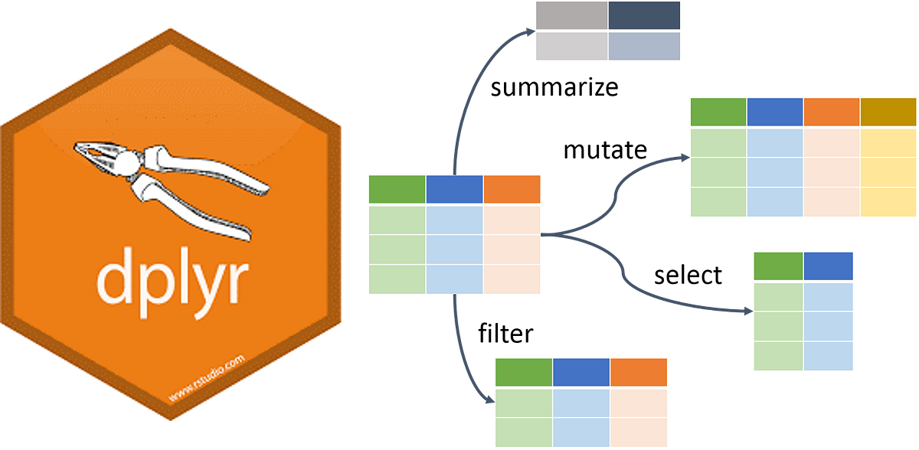
dplyr
Data manipulation and organization
Uses the pipe (%>%) to chain together functions
mutate() to create new columns
select() to select columns
filter() to select rows
summarize() to find mean, median, etc.

Slide 4


tibble
Improved version of the classic dataframe
Does not change column names
  col_names turned to x.col
Does not allow partial name matching with $
  df$ban might return df$banana
Prints only the first 10 rows and displays column type
  As opposed to the whole dataframe
Creation of small tables or tribbles

Slide 5

ggplot2
Data visualization
Aesthetics (colors and axes)
Plot types (scatter, box, histogram, etc.)
Scales (more colors)
Models (linear, quantile, etc.)
Labs (refine title, subtitle, axes names, labels and their angles, etc)

Slide 6

readr
csv file
Import
tidy
analyze/visualize
communicate

Slide 7

tidyr
Rules according to tidyverse:
Each variable is a column; each column is a variable
Each observation is a row; each row is an observation
Each value is a cell; each cell is a single value
Using functions pivot_longer(), pivot_wider(), and more

Slide 8

stringr
Detects patterns in text, and then these texts can be
Manipulated
str_subset(x, "[aeiou]")
#> [1] "video" "cross" "extra" "deal" "authority"
str_count(x, "[aeiou]")
#> [1] 3 1 2 2 4
str_replace(x, "[aeiou]", "?")
#> [1] "why" "v?deo" "cr?ss" "?xtra" "d?al" "?uthority"
str_replace_all("_", " ") # underscores -> spaces

Slide 9

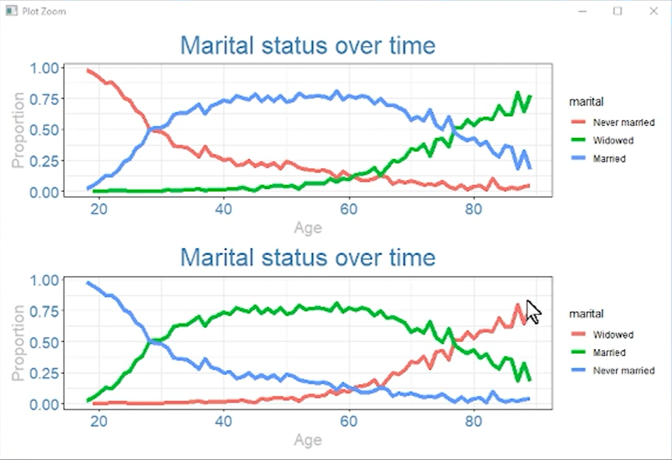
forcats
A factor in R is an categorical variable
Forcats uses:
fct_reorder(): Reordering a factor by another variable.
fct_infreq(): Reordering a factor by the frequency of values.
fct_relevel(): Changing the order of a factor by hand.
fct_lump(): Collapsing the least/most frequent values of a factor into “other”.
R Programming 101

Slide 10

lubridate
Makes dealing with dates in R more streamlined
ymd(20101215)
#> [1] "2010-12-15"
mdy("4/1/17")
#> [1] "2017-04-01"

Slide 11

purrr
Allows you to convert the data type of a list and vectors(for ex: integer to character)
Can apply functions to lists and vectors
Can apply to one or more lists and vectors
map_df(as.character)
map_dbl(1:5, sqrt)
map_df(min_to_sec)
map_df(function(x) x * 60)
map2()

Slide 12

Today’s tutorial
We’ll be going over:
dplyr - data manipulation and organization
ggplot2 - data visualization
tidyr - data tidying
readr - importing data into R
stringr – selecting data
forcats – reordering data
tibble – tiny table tribble
Big thanks to R for Data Science

